Slide 1
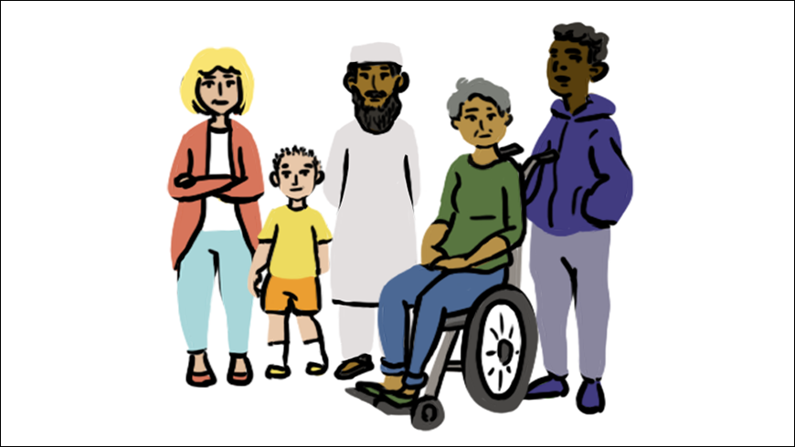

Slide 2
  What do you notice about this group of people?
  How are they different from each other?

Slide 3
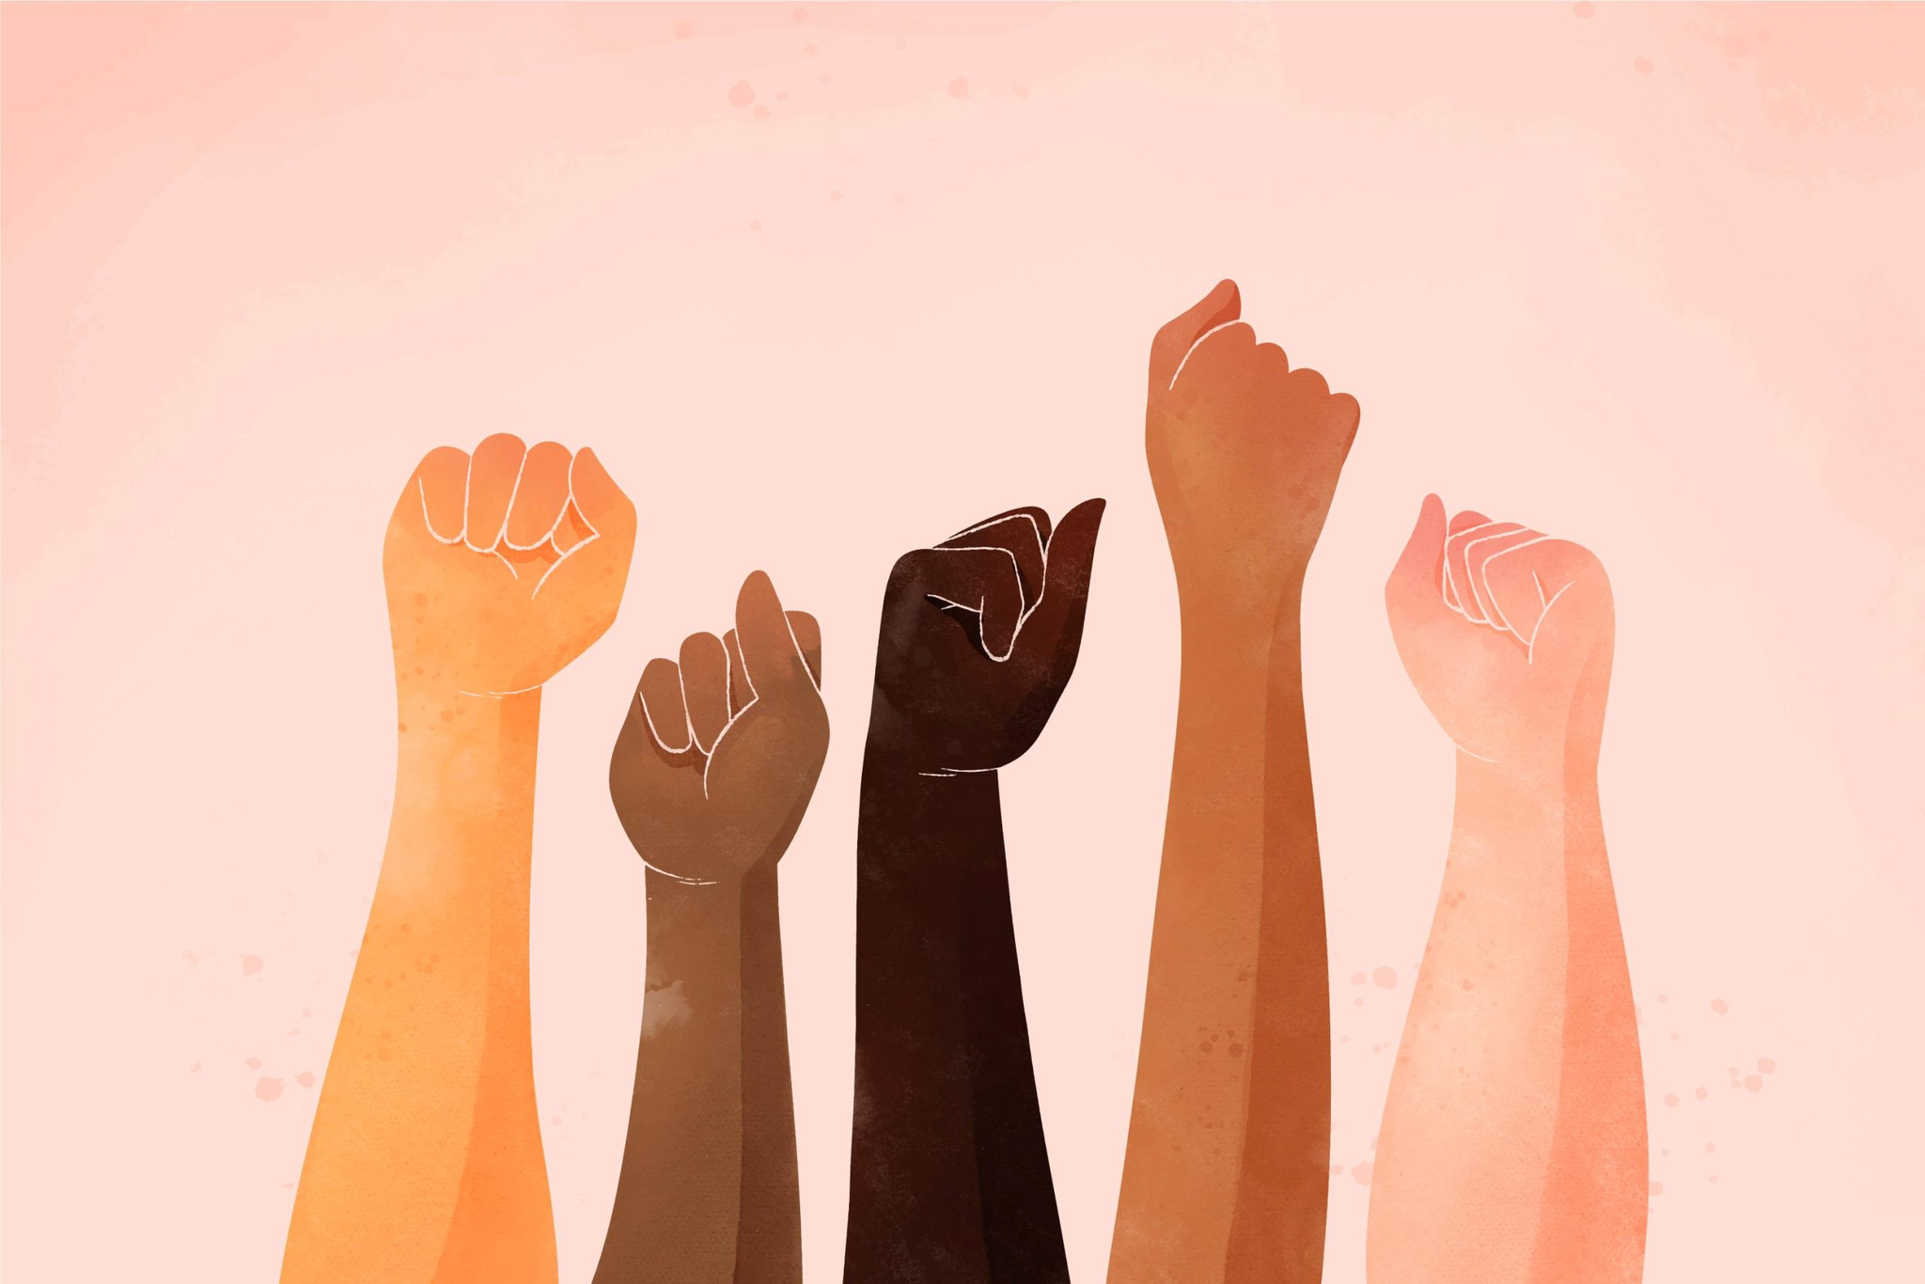
"Despite differences, all people deserve equal opportunities and fair treatment—but that doesn’t always happen."

Slide 4
Discrimination
Discrimination is when someone is not enjoying equal rights due to certain reasons.
In other words, we can say.
Discrimination means treating someone unfairly or differently just because of who they are.
There are two common types of Discrimination:
Direct Discrimination and Indirect Discrimination

Slide 5
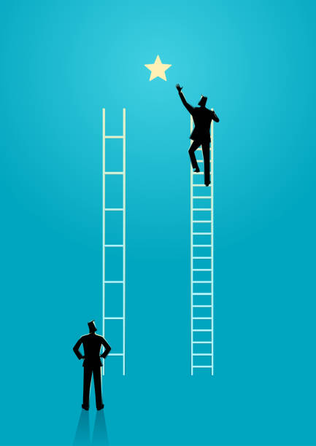
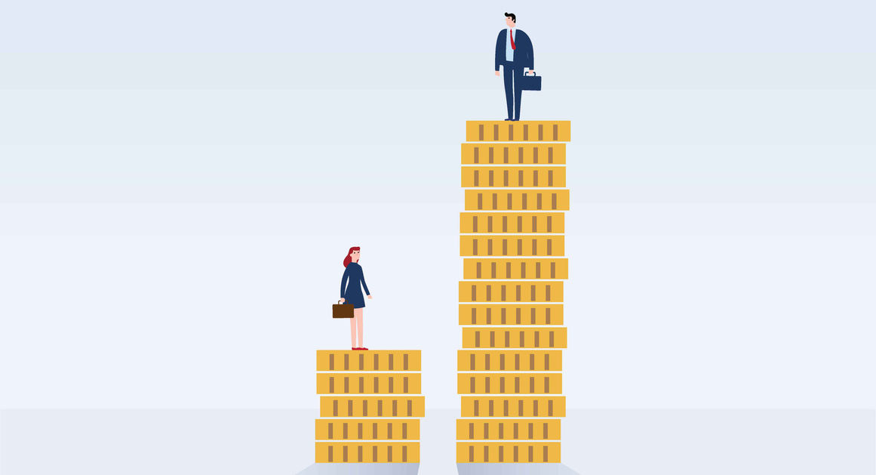
Direct Discrimination
This happens when a person is treated unfairly on purpose because of their identity.
Direct Discrimination Occurs when someone is judged based on their protected characteristics.
  Age
  Gender
  Race
  Religion
  Disability
  Marital Status
👉 In direct discrimination, the unfair treatment is clear and intentional.

Slide 6
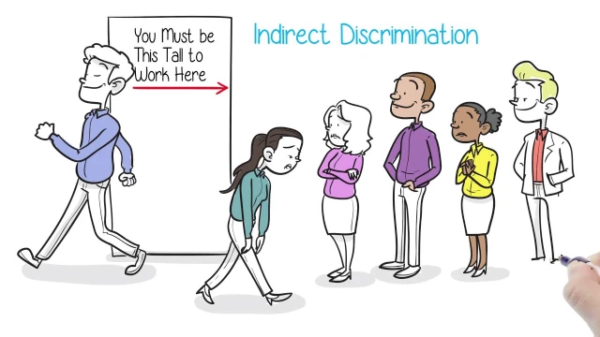
Sometimes, indirect discrimination can be allowed if there is a valid reason. For example, a firefighter job may require a certain level of physical strength for safety reasons.
InDirect Discrimination
This happens when a rule or policy applies to everyone but ends up being unfair to a particular group.
Sometimes, indirect discrimination can be allowed if there is a valid reason. For example, a firefighter job may require a certain level of physical strength for safety reasons.
👉 In indirect discrimination, the rule might look fair but actually disadvantages certain people.

Slide 7
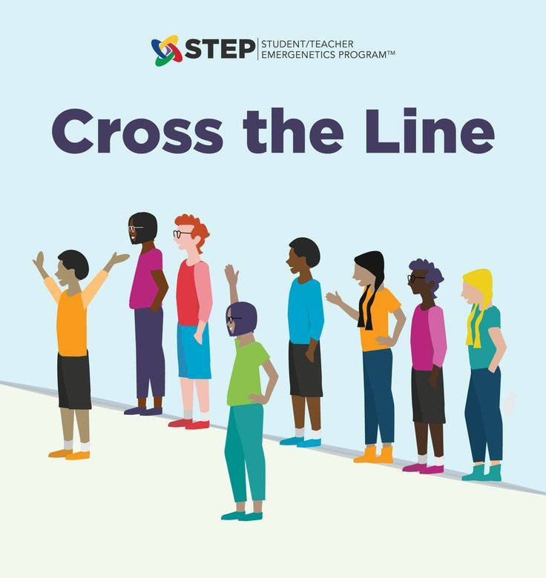
Everyone is equal
but different
Activity:
Take a step forward
ref: Council of Europe
Topic: Human Rights Education
Rights:
• The right to equality in dignity and rights
• The right to education
• The right to a standard of living adequate for good health and well-being

Slide 8
What can we do to stop discrimination?

Slide 9
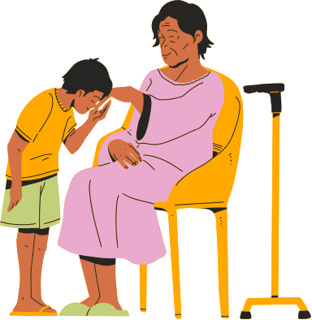
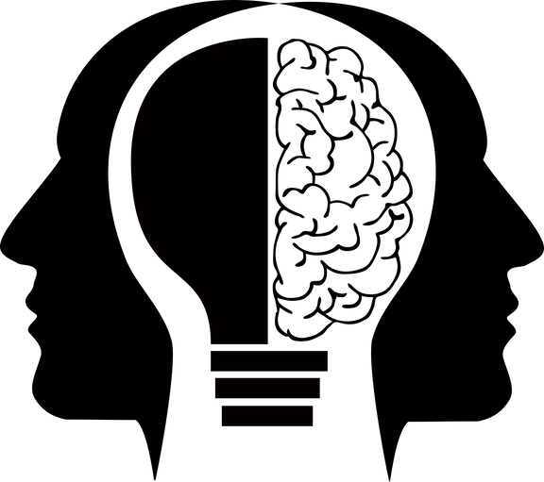


How to Prevent Discrimination
Be Respectful
Be open
Be non-judgemental
Be conscious

Slide 10
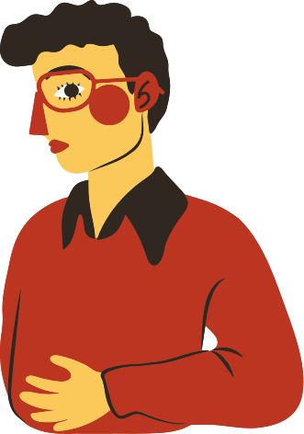
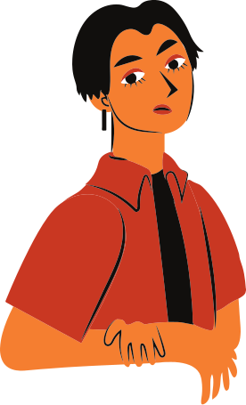
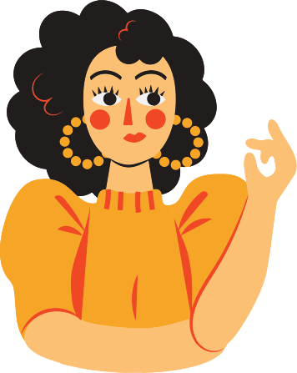
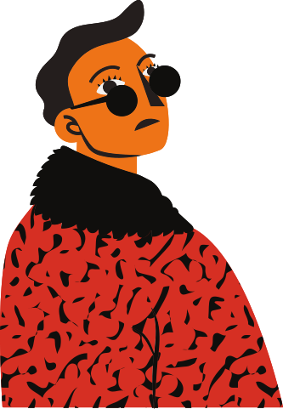
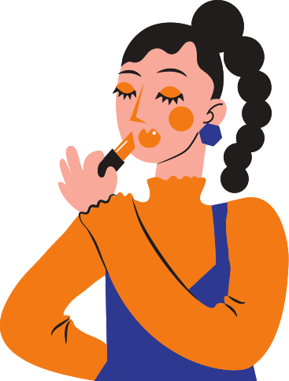
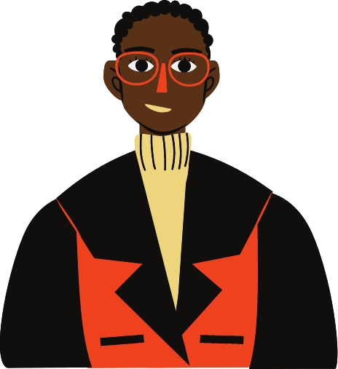
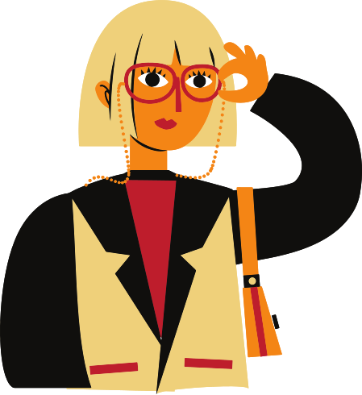
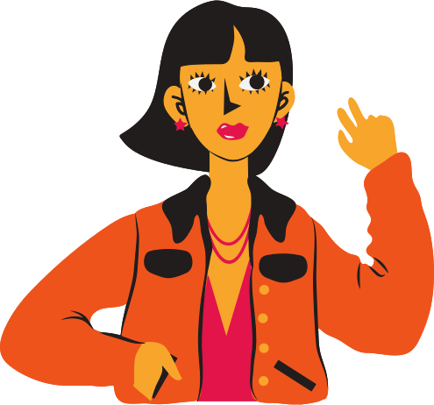
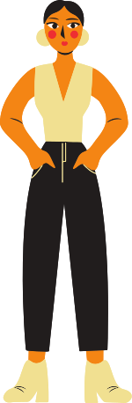
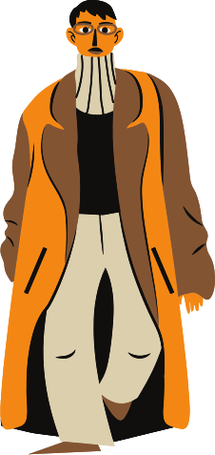
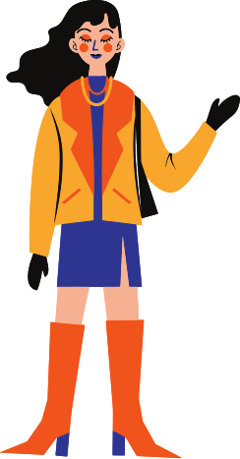
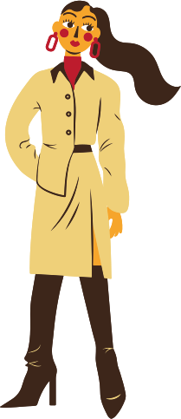
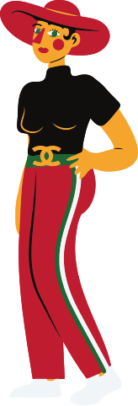
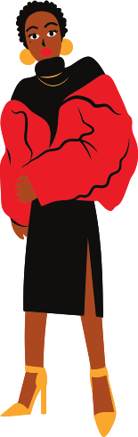
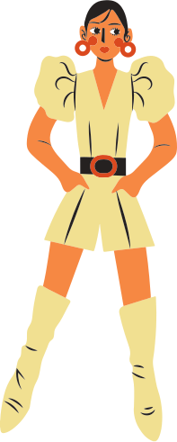
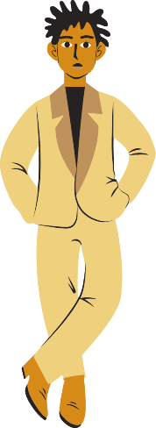
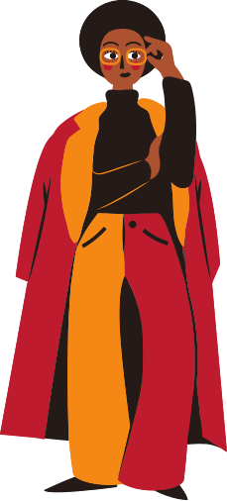
Thank you and remember
Despite differences, all people deserve equal opportunities and fair treatment—but that doesn’t always happen.
It’s up to us to make it better

