Slide 1
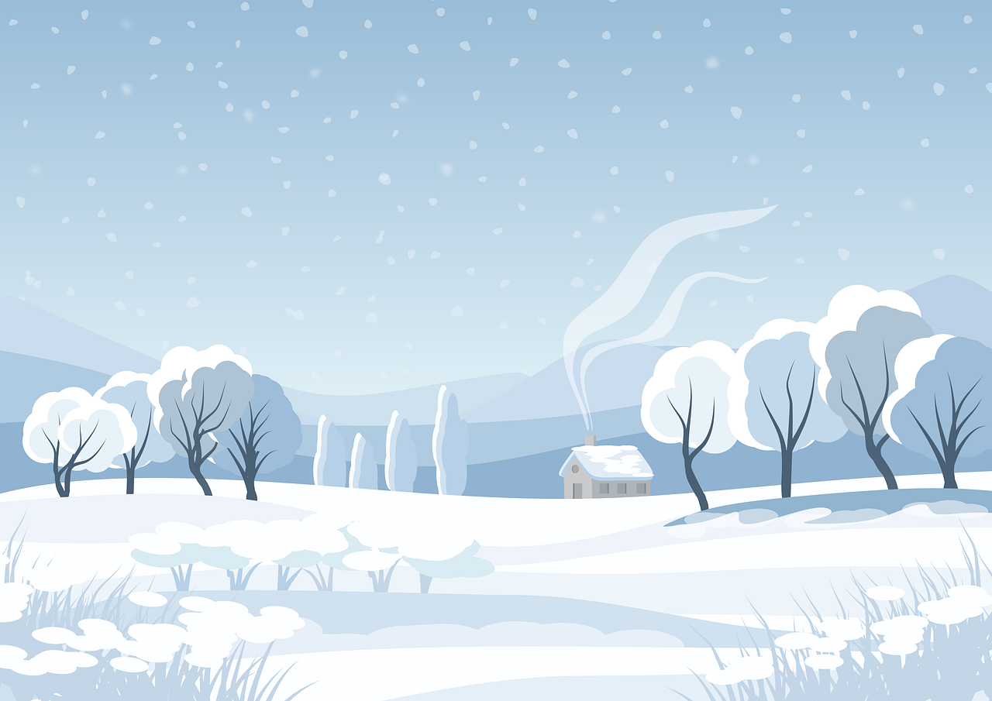



Let's
Explore Antarctica!

Slide 2


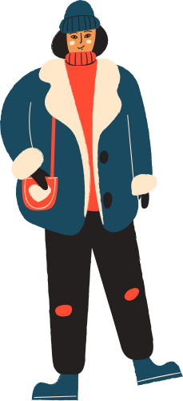

Where is Antarctica?
Antarctica is surrounded by the Southern Ocean, a vital part of Earth’s climate system.

Slide 3

Ice In Antarctica
About 98% of Antarctica is covered by the Antarctic ice sheets. The largest Ice Sheet in Antarctica is the East Antarctic Ice Sheet, which holds an enormous amount of ice.
About 70% of the world’s fresh water is stored in Antarctica's ice.

Slide 4


Melting of Ice
Antarctica's ice is melting mainly due to global warming caused by rising carbon dioxide (CO₂) levels.
Since 1992, melting Antarctic ice has added about 8 millimeters to global sea levels.

Slide 5

Risks
Penguins and seals are among the animals most affected by melting ice, as they depend on it for survival.
When large chunks of ice detach from glaciers, it's called calving. This occurs when the ice becomes unstable due to factors like melting, stress from its own weight, or the movement of glaciers toward the ocean

Slide 6


Studying Antarctica
Studying Antarctica's ice is crucial to understanding and preparing for rising sea levels.
Satellites like GRACE (Gravity Recovery and Climate Experiment) monitor changes in Antarctica's ice mass.

Slide 7

Thank You!

Slide 8
Save Antarctica
Despite being the coldest region on the planet, the Antarctic supports a huge array of life. Whales migrate thousands of miles to gorge on swarms of tiny krill. The seafloor is home to creatures like corals and sea stars, with new species discovered on a regular basis. Huge colonies of penguins breed on land and hunt in the sea, surviving the dark Antarctic winters by huddling together.

Slide 9
