Slide 1
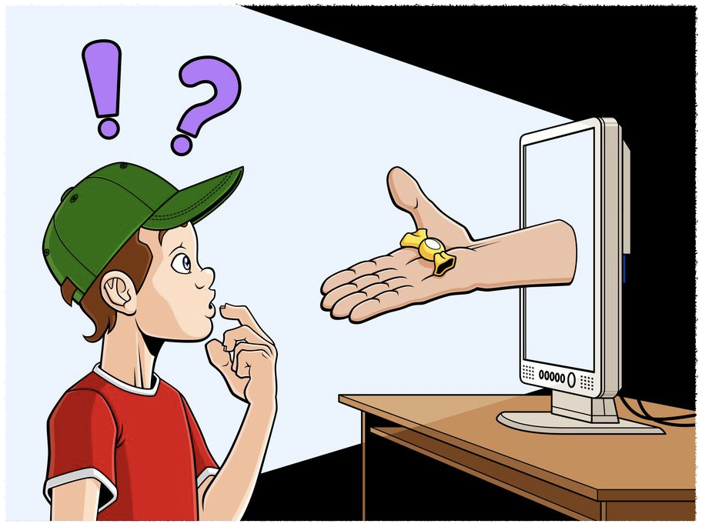
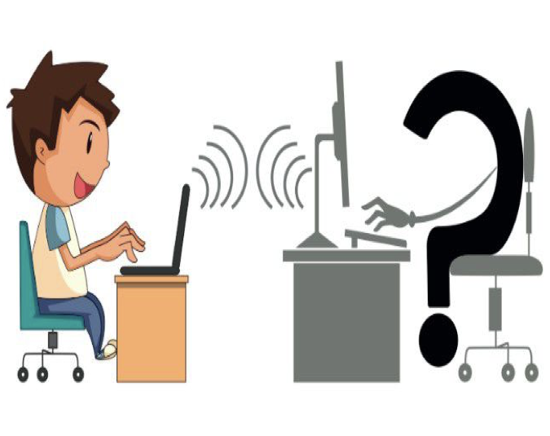
MICROTEACHING Good morning, class!
What do you think about these Images?

Slide 2
Today, we're going to talk about something really exciting.
Online Safeguarding.
How we can protect ourselves online.

Slide 3
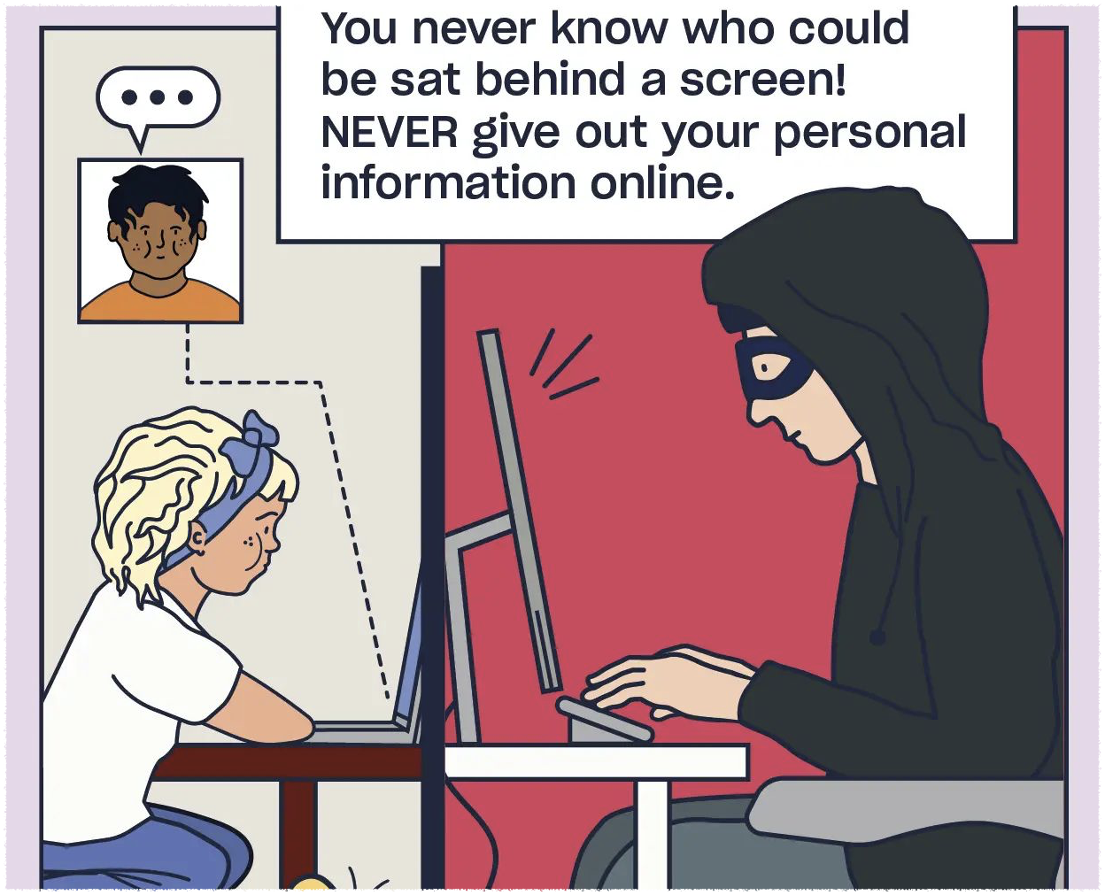
Don’t share your sensitive information online.
Do you know which information is sensitive?

Slide 4
Personal Information:
Information you should not share online.
Full Names | Passwords
Home Addresses | School Name
Phone Numbers | Photos
Email Address | Financial Information

Slide 5
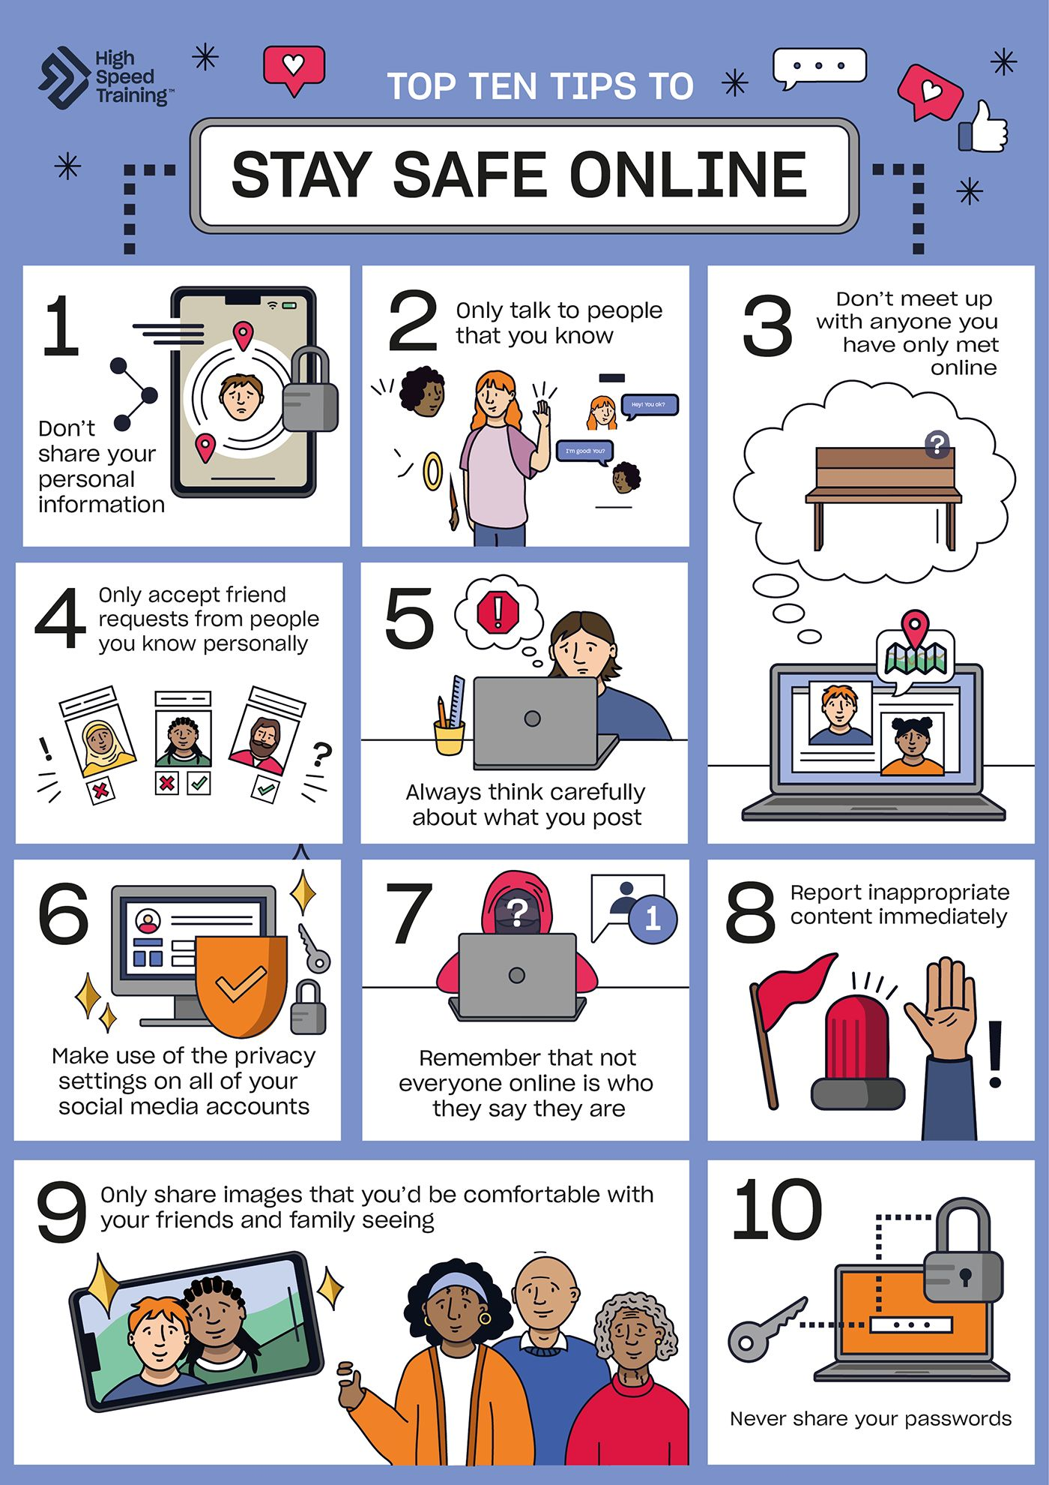

Slide 6
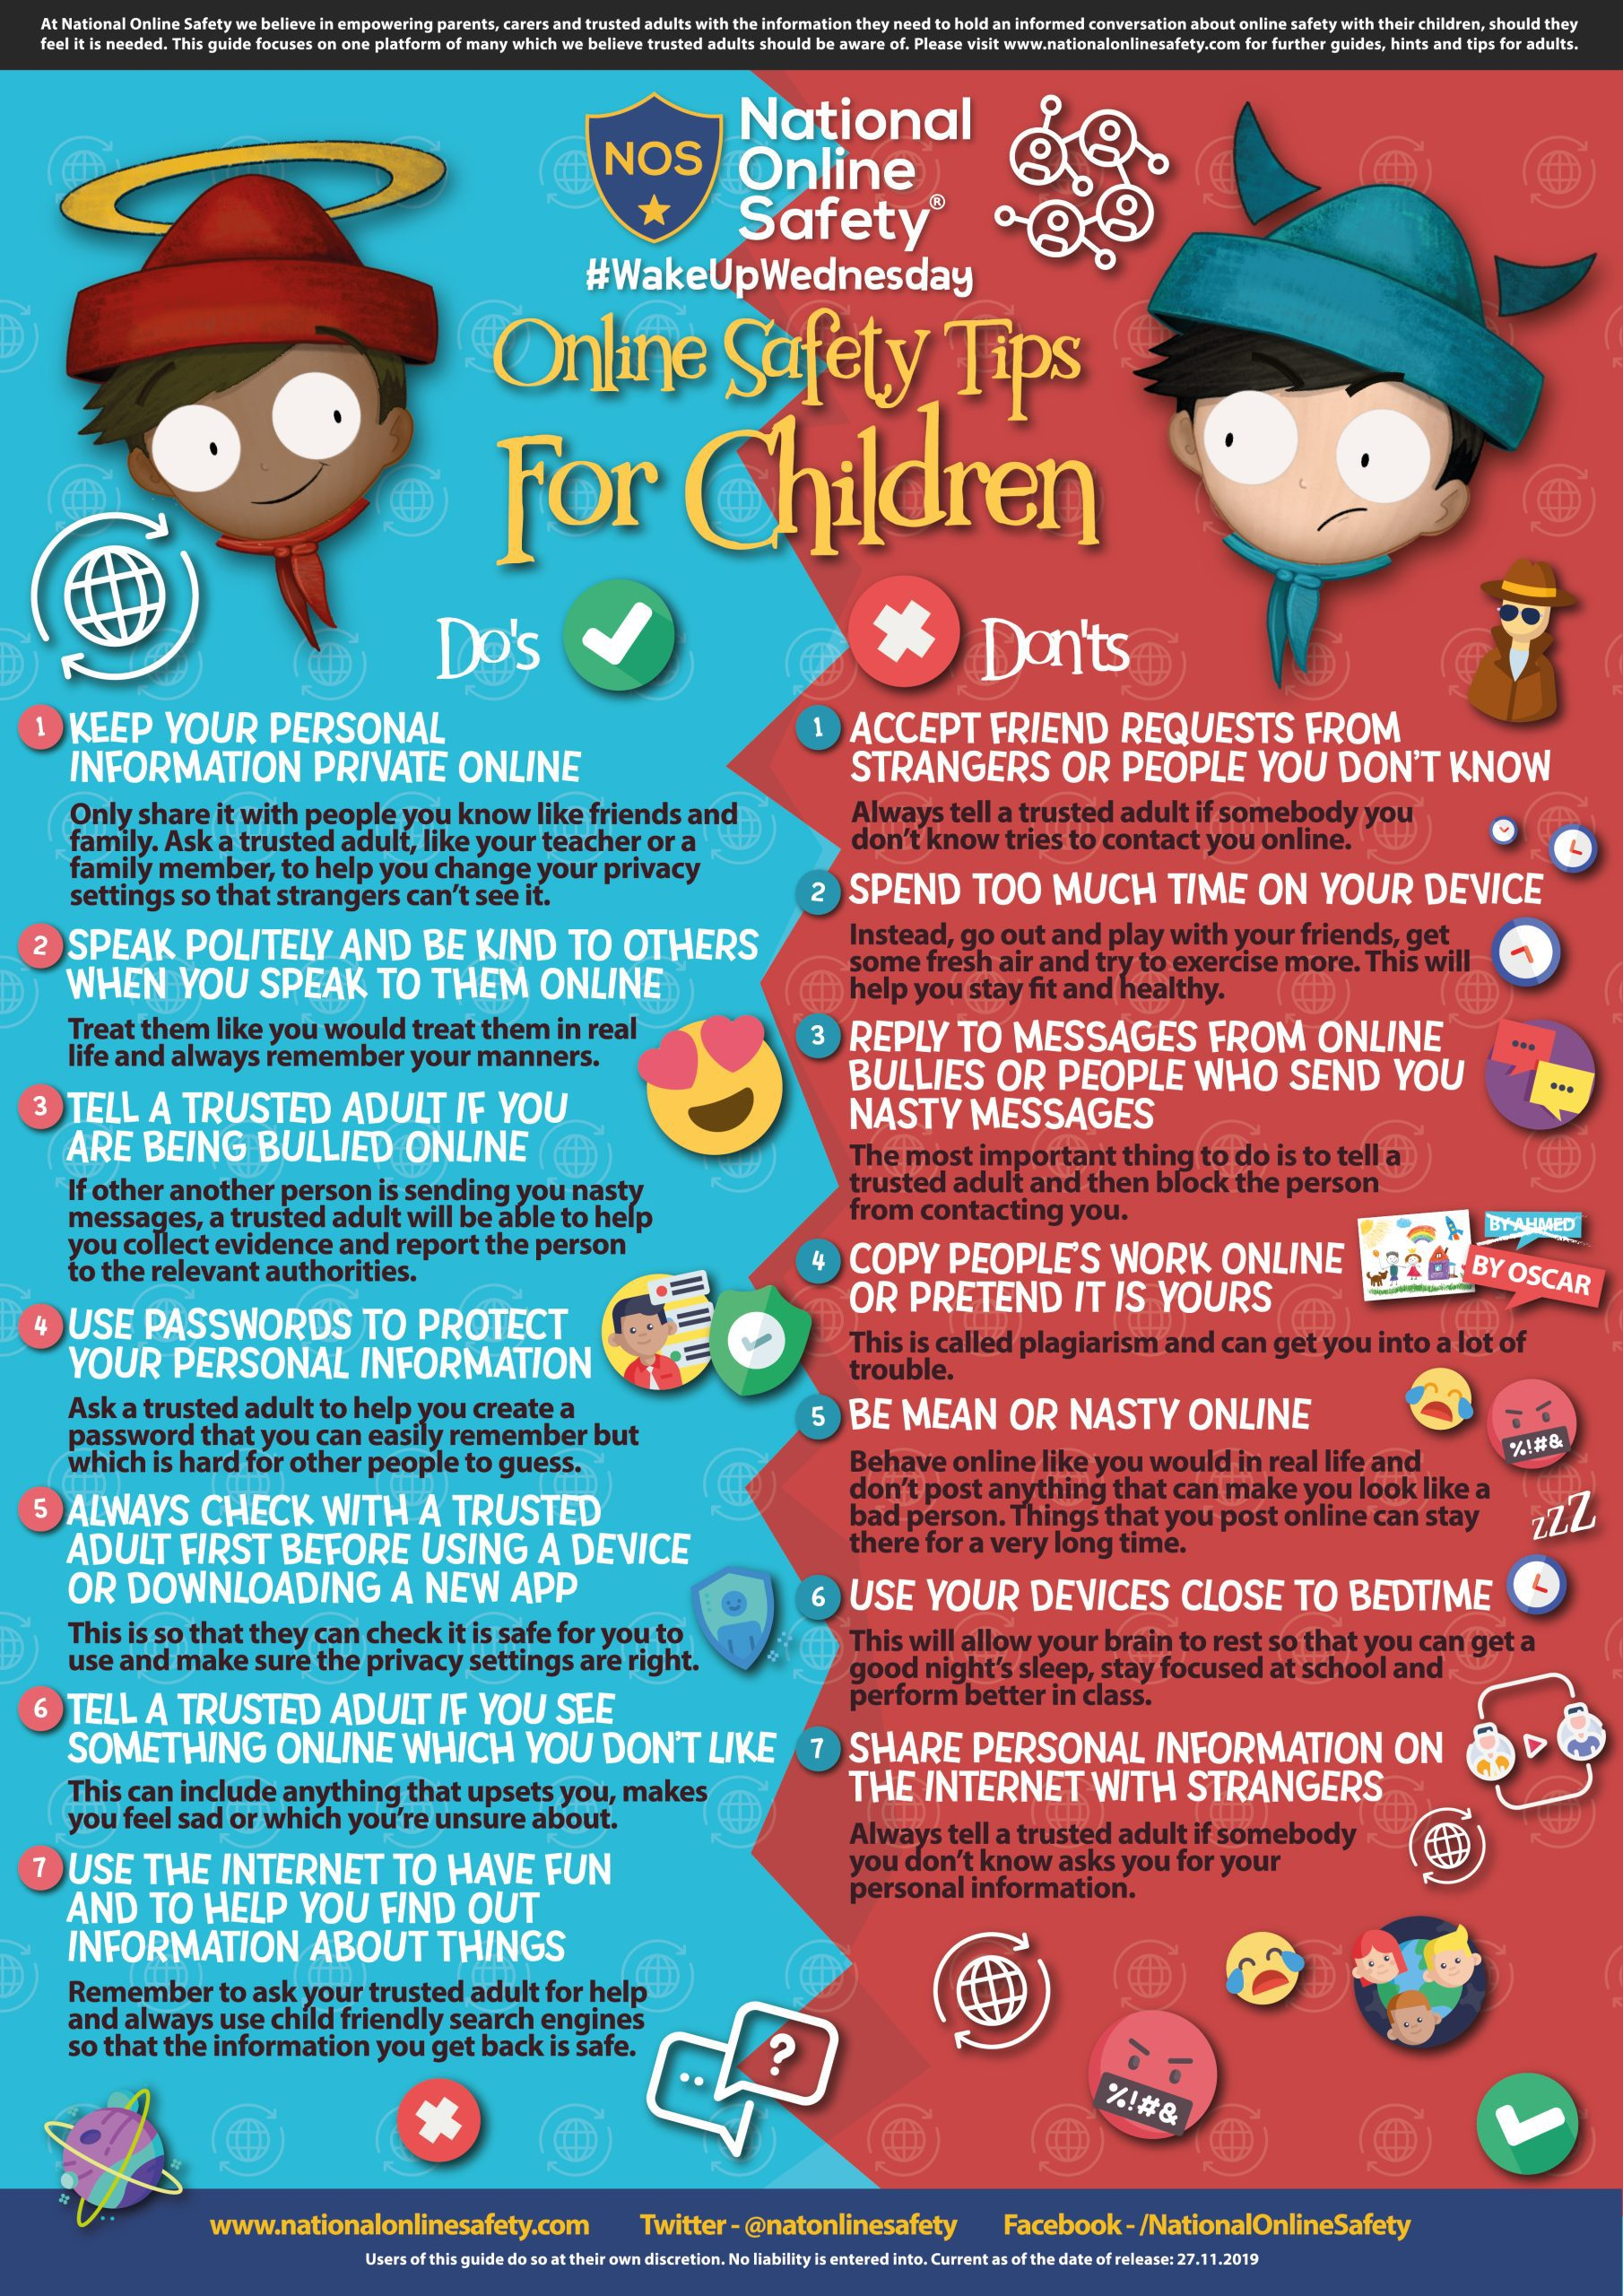

Slide 7
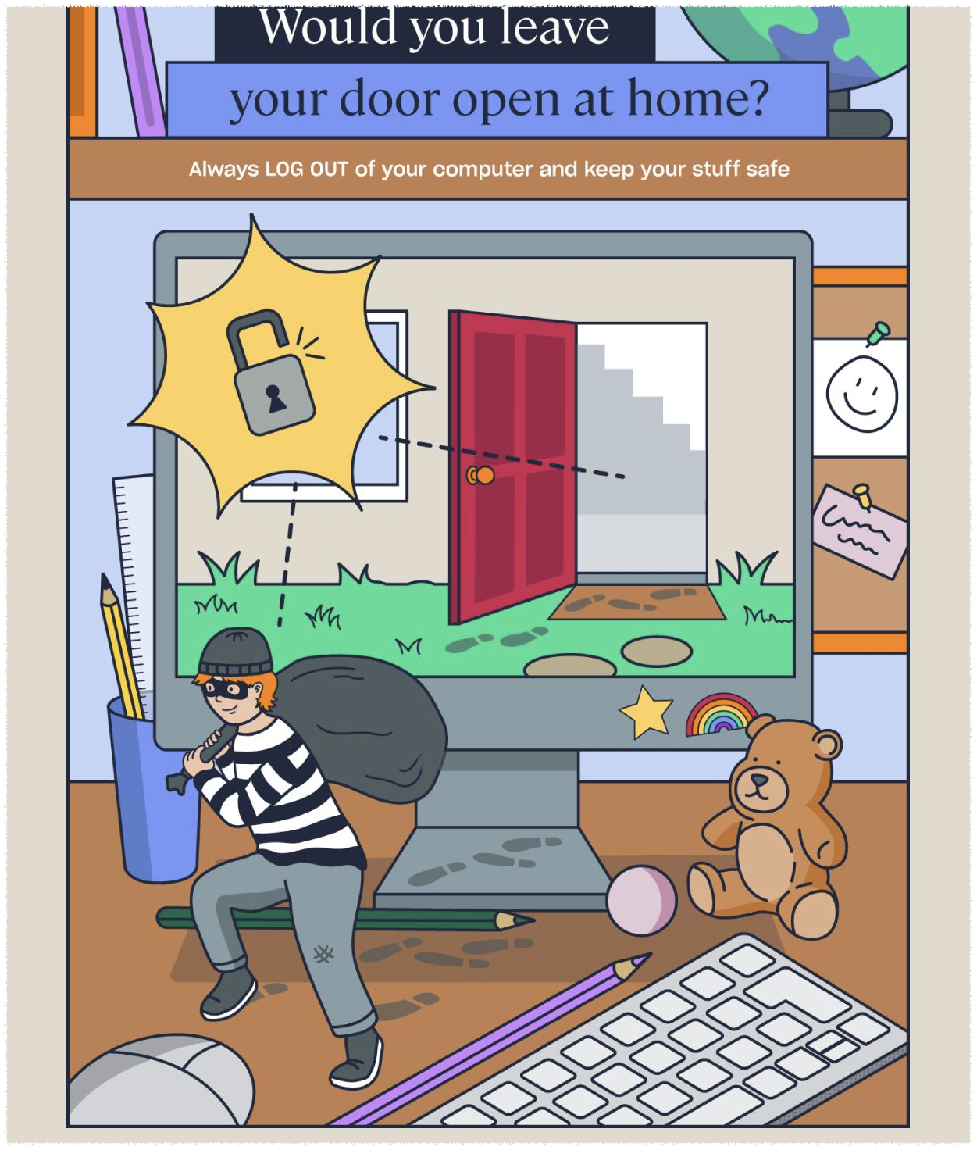
Don’t Know,
Don’t Show, Don’t Share

Slide 8
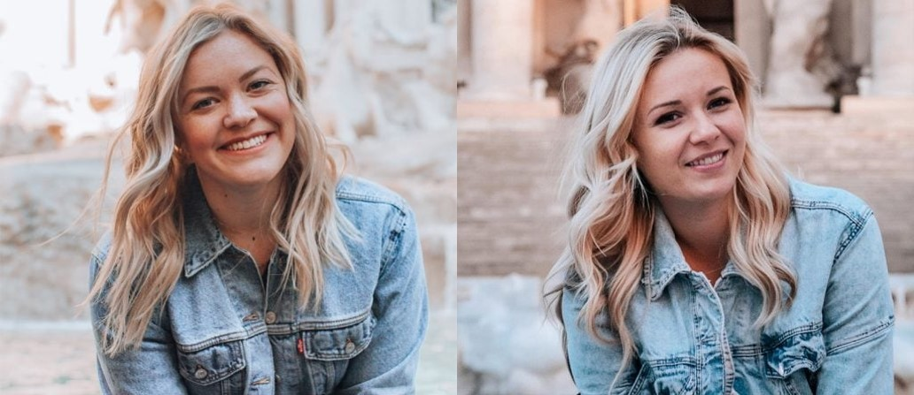
What do you think which picture is real?

Slide 9
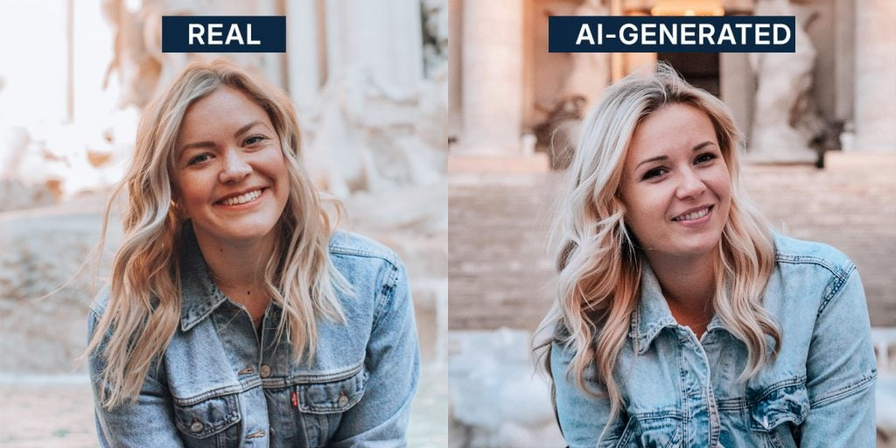

Slide 10
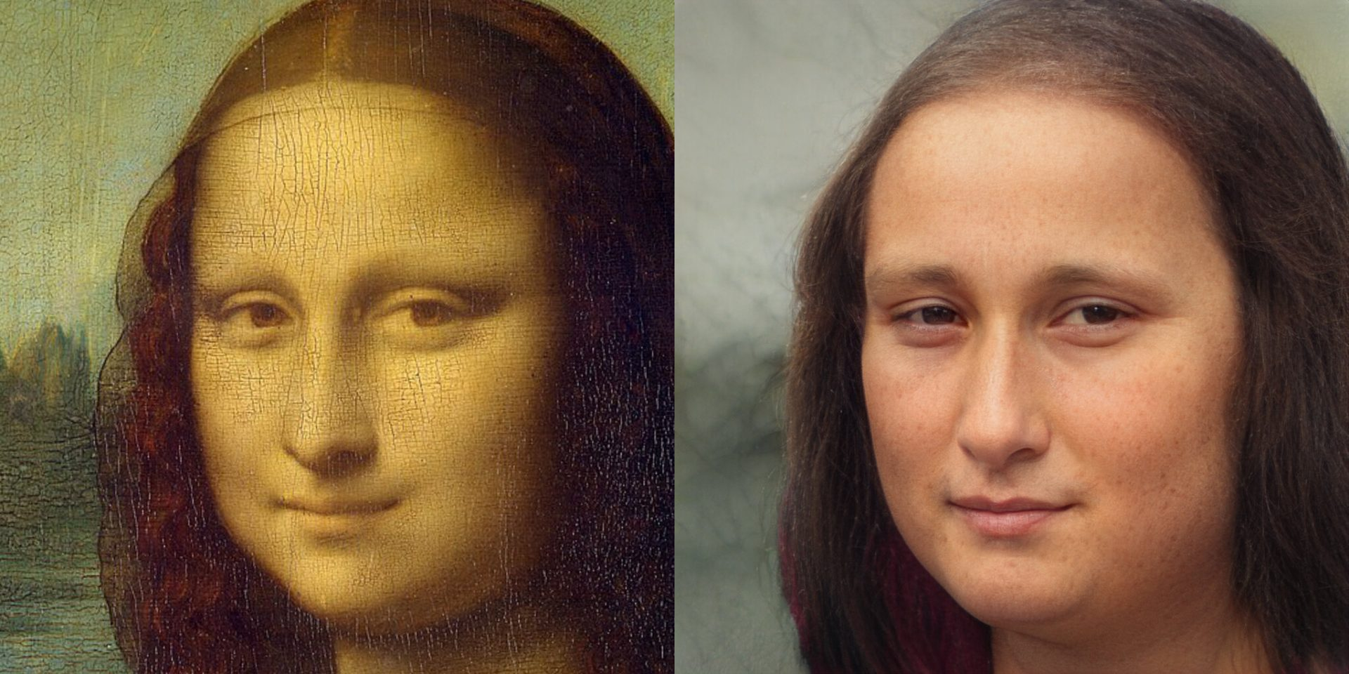
Easy to Guess

Slide 11

Real & Fake Video (Hard to Guess)

Slide 12
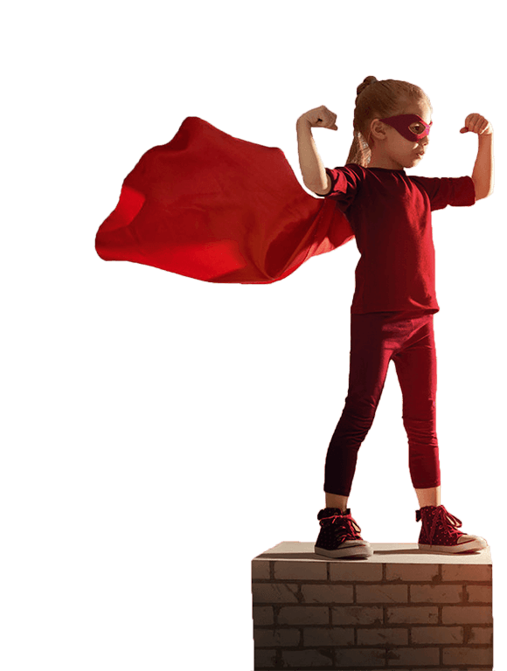
Be a web hero: spread kindness, share with care!
Always talk to your teacher, parent, or guardian. If you have any concerns about online safety.

