Slide 1

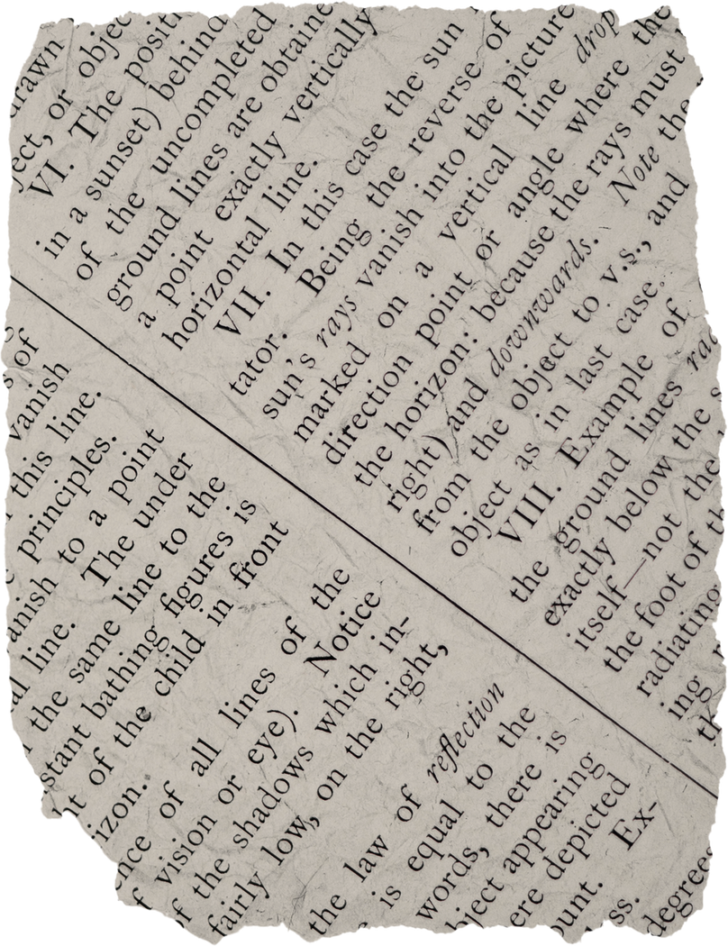

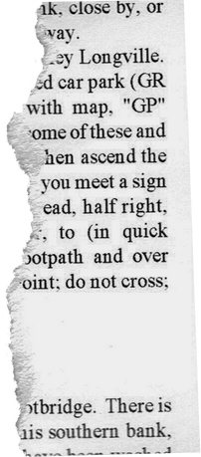
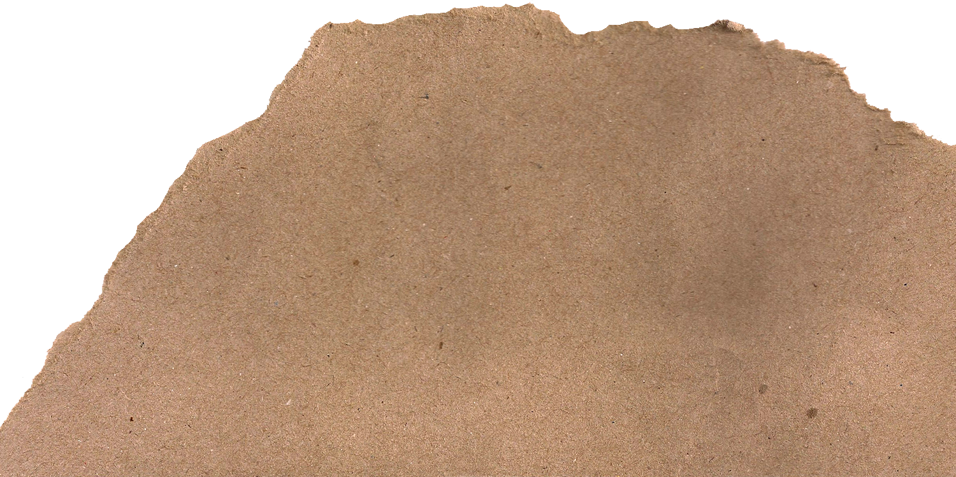

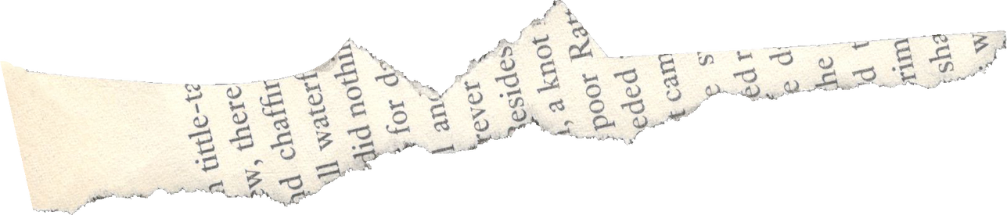
Theater of the oppressed
ACTING FOR CHANGE

Slide 2
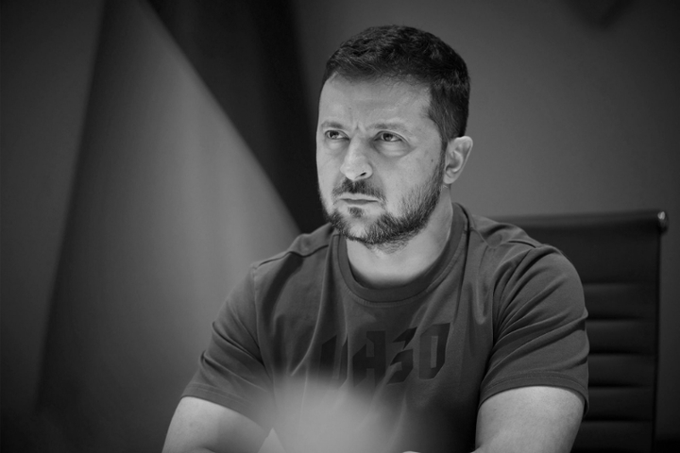


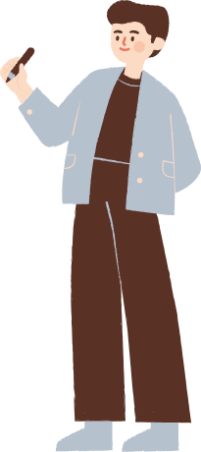
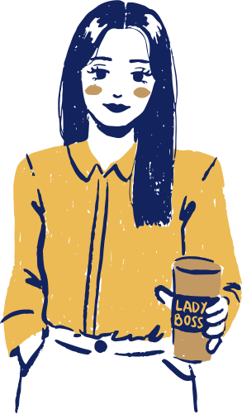
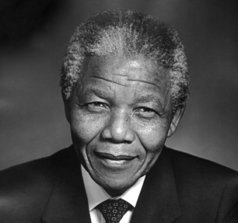



Meet THE Leaders
UMAIR
ZOHA
NAUMAN
HINA
SHAHZAD
MARYAM
TAYYAB

Slide 3
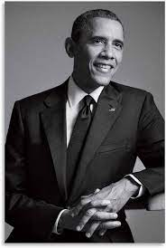
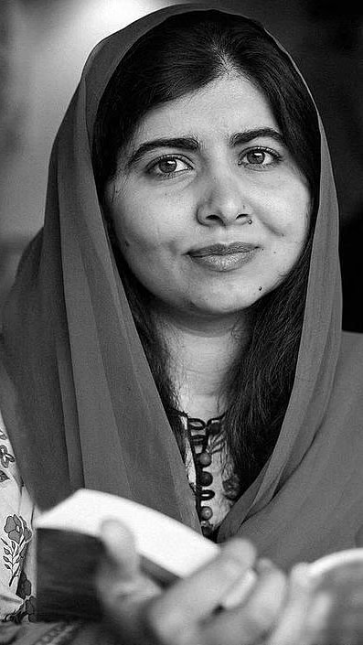
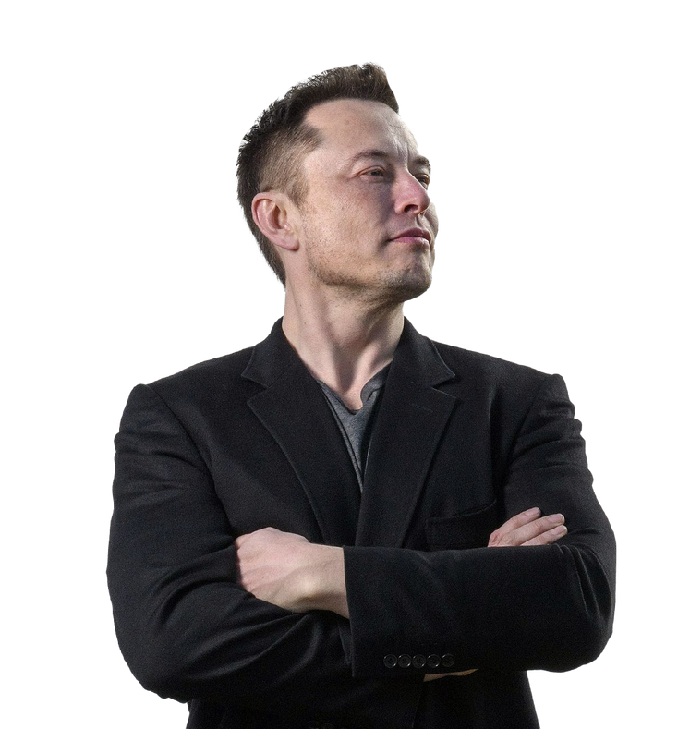
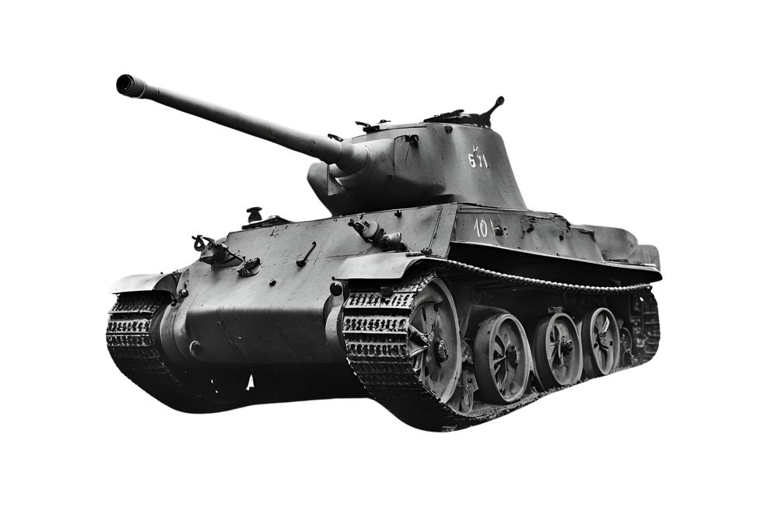
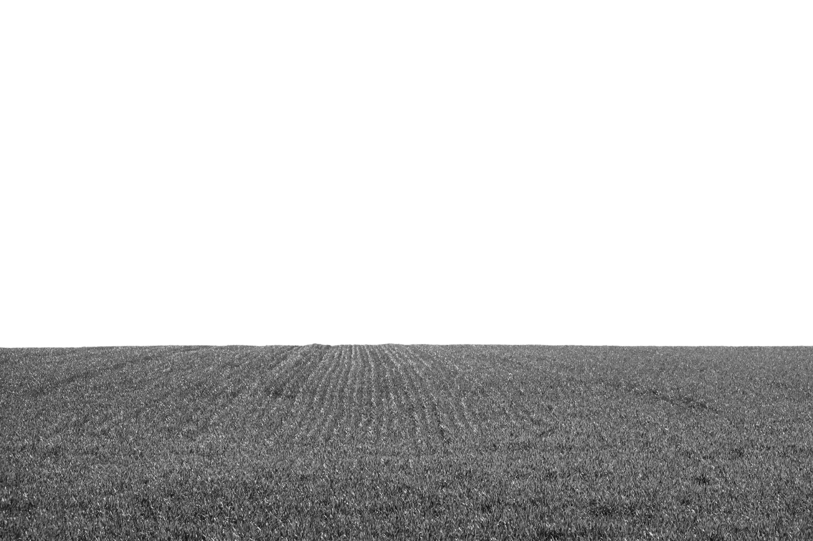
Who shapeS the future?
Look around—it's you. You are the leaders of tomorrow. The decisions you make, the actions you take, and the values you stand for will define the world in the years to come. Leadership isn’t just about power or titles; it’s about standing up for what’s right, inspiring change, and lifting others with you.
Today, we step into the Theater of the Oppressed, where leaders are like actors—some unite, some divide, but all leave a mark. Through games, storytelling, and reflection, we’ll explore what makes a great leader and how you can shape a future worth believing in. So, are you ready to take center stage?

Slide 4
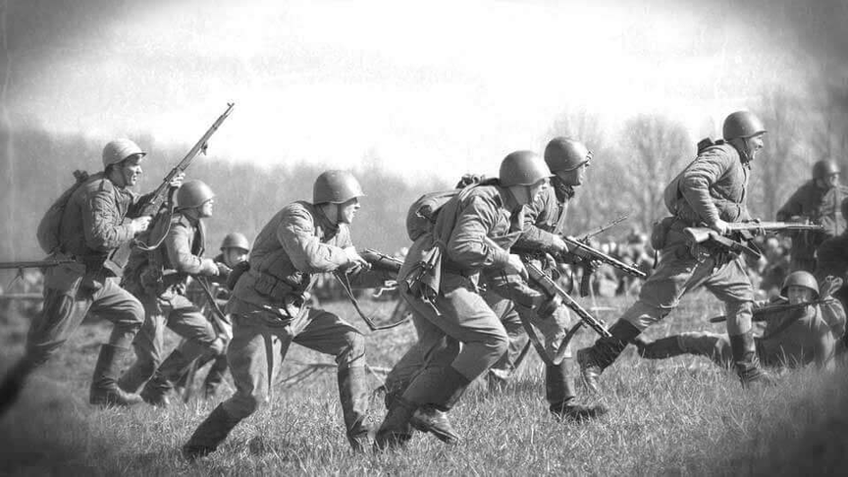
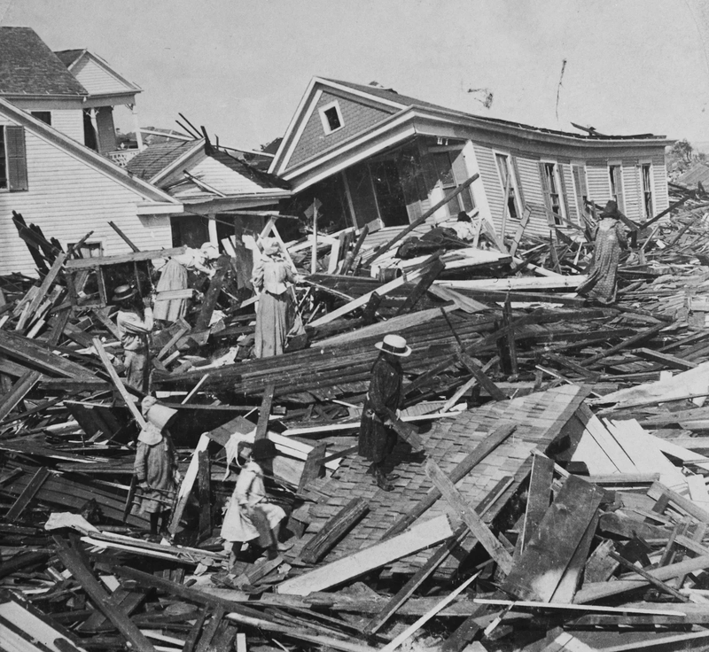
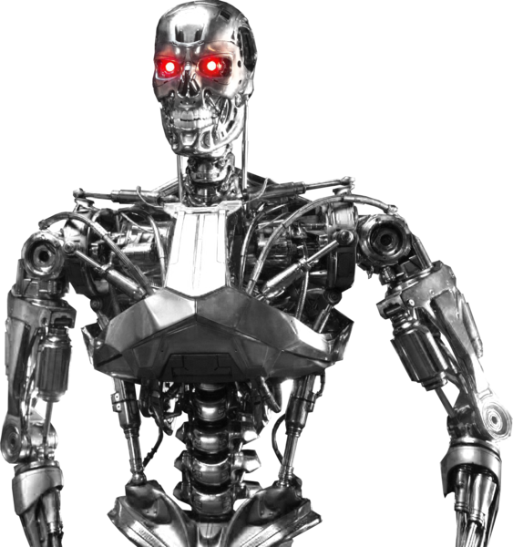
2050 Newspaper
Close your eyes for a moment and imagine... It’s the year 2050.
What does the world look like? Have we solved the biggest challenges—climate change, inequality, poverty? Have new technologies transformed how we live? Who are the leaders shaping this future?
Today, you are not just students; you are journalists from the future! Your task is to write a news from the year 2050. Be creative! Your newspaper can report a world-changing event, a powerful movement, or even a surprising challenge. There are no limits—your imagination is the future!
Grab your "2050 Newspaper" and start writing the headlines of tomorrow!

Slide 5
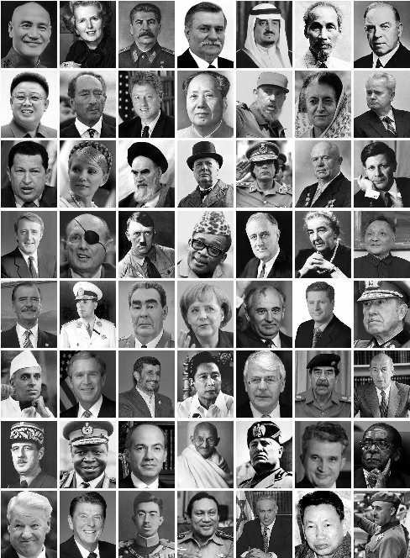
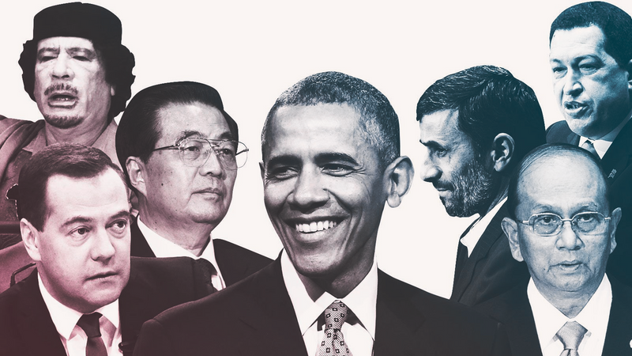
Leaders solving Problems
"Great leaders don’t just talk—they take action. Throughout history, leaders have faced challenges like inequality, climate change, and conflict. But how did they respond? And what would they do if they were here today?"
In this activity, you’ll step into the shoes of a leader—past, present, or even the future—to solve a real-world problem. Your mission is to think like a leader, make bold decisions, and create a strategy for change.
Let’s see how leadership can shape a better world!

Slide 6
Guess the Leader
Can you recognize a leader just by their traits and actions?

Slide 7

LINE OF HOPE
"Every great leader starts with a vision—an idea of a better world. Today, we’re going to create our own vision for the future."
Here’s what we’ll do:
Write or Pick any hope from a piece of paper.
Form a line together, holding up your hopes.
Express it! We’ll read them aloud, and create a collective sound.

Slide 8
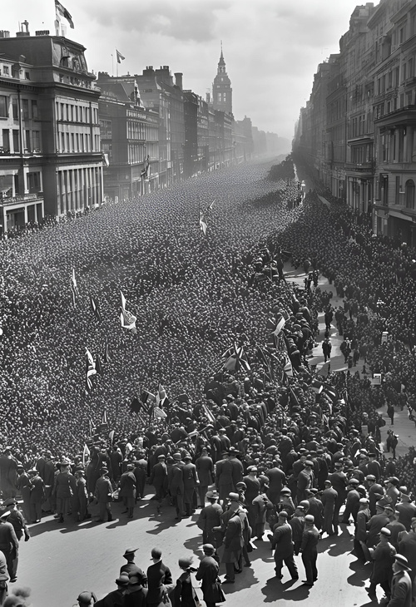

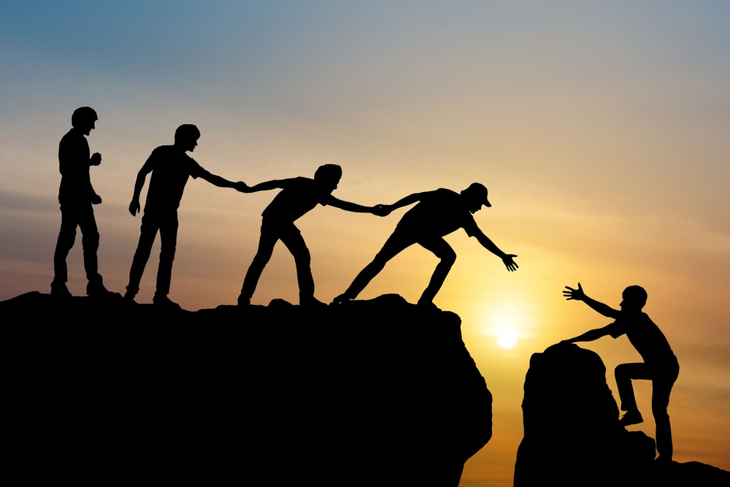
2050 Newspaper of Change/Hope
"Earlier, you imagined the future as it might unfold. Now, let’s rewrite that future—not just as spectators, but as the leaders shaping it."
The future isn’t written yet, but today, you get to shape its headlines. Let’s create a world worth reporting on!

Slide 9
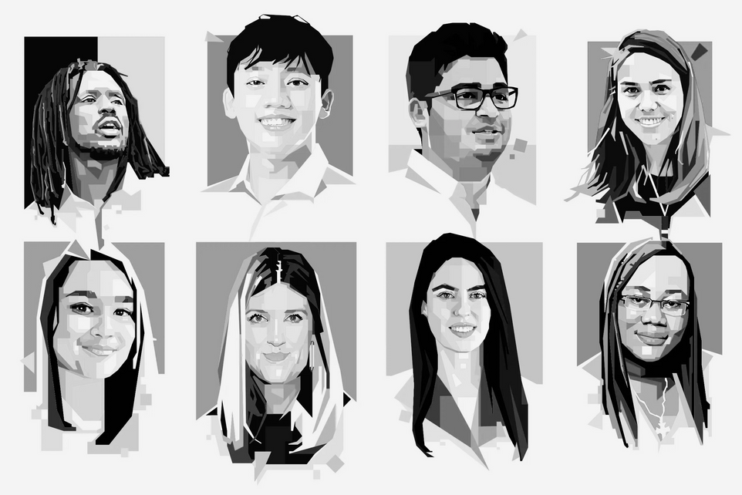
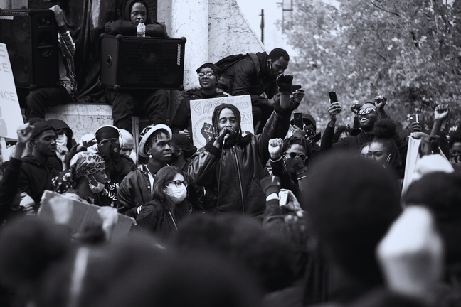
Today, we’ve explored the power of leadership—the voices that shaped history and the changes that built a better world. But remember, leadership isn’t just about the past—it’s about the future. And that future is YOU.
You are the leaders of tomorrow. The choices you make, the values you stand for, and the hope you carry will shape the world in ways we can’t yet imagine. Every great leader once started as a dreamer, just like you. So dream big, take action, and never forget—the future is in your hands. Go out and lead with courage, kindness, and purpose!

Slide 10
Thank You.

